Slide 1
Exploratory Data Analysis Of PCM Data
Objective: To find relationship between DTC code P007E/F and given sensor data.

Slide 2
Data Stats Summary
TIMESTAMP - time at which the event is recorded - Unix Time (POSIX time) in milliseconds. Ex: 1502902504267 – 2017-08-16T16:55:04+00:00
MAKE - OEM Name of the Car. Ex: Chevrolet, Ford, Nissan..etc
MODEL - Model described by OEM of a particular Car Ex: Agile (Chevrolet), Focus (Ford)..etc
CAR_YEAR - Year which car is manufactured.
ENGINE_POWER - Normally it refers to the maximum power an engine can put out (kW or hp), but in the given data set it refers to the combined volume capacity of all the cylinders. Ex: 1L, 1.4L, 1.6L, 1.8L.
AUTOMATIC - Tells us whether the car supports automatic transmission or not. Ex: n – no , s – yes.
VEHICLE_ID - ID of each test car. Ex: car1 – Chevrolet Agile, car2 – Ford eco_sport.

Slide 3
Data Stats Summary
BAROMETRIC_PRESSURE(KPA) - Reading from the BAP Sensor – gives the measure of atmospheric pressure of the environment that the vehicle is driving in. Ex: 100 KPA, 101 KPA.
ENGINE_COOLANT_TEMP - Reading from the ECT Sensor – gives the measure of the temperature of the coolant/antifreeze mix in the cooling system, giving an indication of how much heat the engine is giving off. Ex: Normal Operating Range : 195 – 220 F (90.5 – 104.5C)
FUEL_LEVEL - represents % of fuel in the fuel tank. Ex: 90%
ENGINE_LOAD - represents the amount of air flowing through the engine as a percentage of the theoretical maximum. Ex: 85%
AMBIENT_AIR_TEMP - Represents the Ambient Air Temperature Sensor readings which is a measure of semiautomatic/automatic temperature control system of outside air temperature. Ex: 38 C
ENGINE_RPM - measure of frequency of rotation, specifically the number of rotations around a fixed axis in one minute.

Slide 4
Data Stats Summary
INTAKE_MANIFOLD_PRESSURE - Represent the readings from the Manifold Air Pressure Sensor, measure of pressure at inlet manifold (part of engine that supplies fuel/air mixture to the cylinders)
MAF - Represents readings from mass airflow sensor which is a measure of the mass flow rate of air entering a fuel-injected I.C Engine.
LONG TERM FUEL TRIM BANK 2 & BANK 1 – It is a longer term average of what the engine computer has been doing to balance the fuel mixture over a predetermined interval of time. This value is a more accurate indicator of how the fuel mixture is being corrected to compensate for changes in the air/fuel ratio that are occurring inside the engine. (+) fuel trim values mean the engine computer is adding fuel (increasing the pulse width or on-time of the fuel injectors) to add more fuel to the engine. (-) fuel trim values mean the engine computer is subtracting fuel (decreasing the pulse width or on-time of the fuel injectors) to reduce the amount of fuel injected into the engine. Bank 1 or 2 will be the cylinder bank that has cylinder number one or two in the engine firing order.
FUEL_TYPE - Type of fuel used in the car. Ex: Biodiesel_Ethanol, Biodiesel_Gasoline

Slide 5
Data Stats Summary
AIR_INTAKE_TEMP - Represents readings from the IAT (Intake Air Temperature Sensor), measure of temperature of air entering the engine.
FUEL_PRESSURE - Represents the readings of the fuel pressure gauge when attached to the fuel pump. Ex: 48 psi
SPEED - measure of instantaneous speed of the vehicle recorded in the speedometer Ex: 130 mph
SHORT TERM FUEL TRIM BANK 2 & BANK 1 - It is the short term average of what engine computer has been doing to balance the fuel mixture right now. The properties of the values are same for that of the Long term fuel trim banks. Bank 1 or 2 will be the cylinder bank that has cylinder number one or two in the engine firing order.
ENGINE_RUNTIME - Current Runtime of the Engine. Ex: 12:03:28 AM.
THROTTLE_POS – Represents the values of Throttle Position Sensor, measure of % of air intake of an engine.

Slide 6
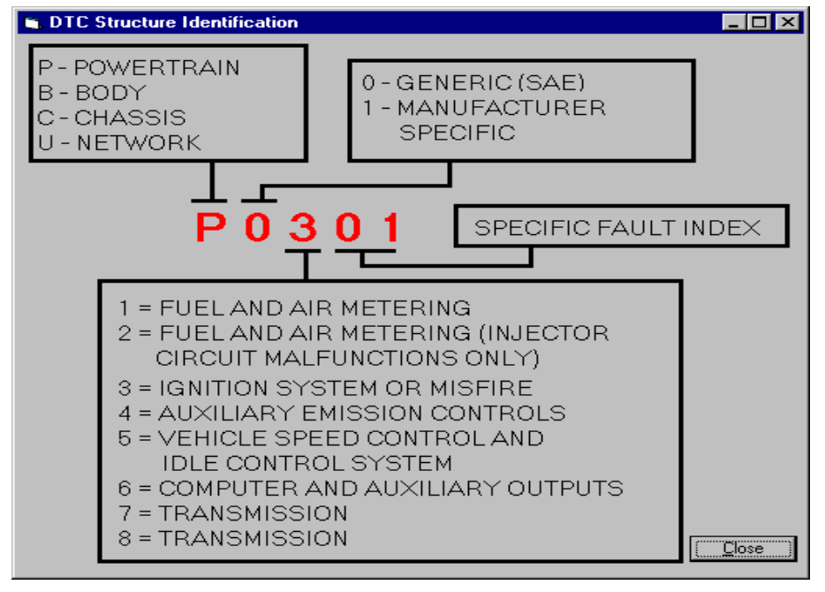
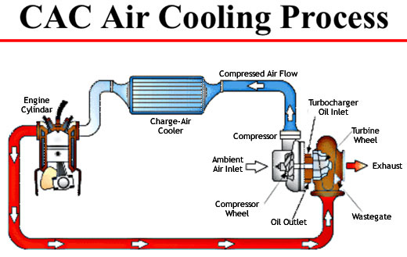
Data Stats Summary
DTC_NUMBER - Diagnostic Trouble Code Numbers. Check Engine Light (Malfunction Indicator Lamp – MIL) is either ON or OFF. They represent particular type of codes depending on MIL status. Ex: MIL is OFF16 codes.
TROUBLE_CODES - Diagnostic Trouble Codes used to diagnose problems related to the vehicle.
P007E - Charge Air Cooler Temperature Sensor Circuit Intermittent. It is set when the PCM detects an intermittent problem with the bank 1 charge air cooler temperature sensor signal.

Slide 7
Data Stats Summary
P007F - Charge Air Cooler Temperature Sensor Bank1/Bank2 Correlation. If the PCM detects voltage signals from the CACT Sensors (for engine banks 1& 2) which reflects a difference that exceeds the max. allowable parameters, code P007F is set and MIL is on.
P2036 – Exhaust gas Temperature Sensor Circuit High Bank 2 Sensor 2. If PCM detects incorrect or high temperature signal from EGT sensor, then the code P2036 is set.
EQUIV_RATIO - Normally Air-fuel ratio (AFR) = Mair / Mfuel. Stoichiometric AFR (AFRstoich) has the correct amount of air and fuel to produce a chemically complete combustion event.
Air-fuel equivalence ratio = AFR / AFRstoich For rich mixtures it is <1.0 and for lean mixtures it is >1.0

Slide 8
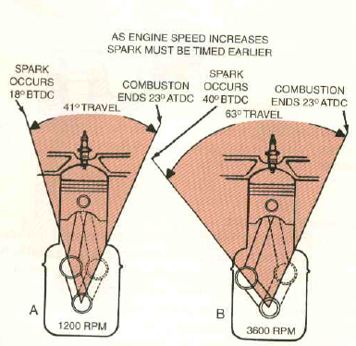
Data Stats Summary
TIMING_ADVANCE – Ignition Timing refers to the timing relative to the current piston position and crankshaft angle, of the release of a spark in the combustion chamber near the end of the compression stroke. "Timing advance" refers to the number of degrees before top dead center (BTDC) that the spark will ignite the air-fuel mixture in the combustion chamber during the compression stroke.
MIN – Number of minutes the fault was prevailing.
HOURS – Number of Hours the fault was prevailing.
DAYS_OF_WEEK – The no. of days in a week of the mentioned month the fault was prevailing.
MONTH – particular month at which the fault occurred. Ex: 8 - August
YEAR – year at which the fault occurred in the car.

Slide 9
Constant Variables
Observed Constant Variables are
MAKE: citroen
MODEL: c3
CAR_YEAR: 2013
ENGINE_POWER: 1.4
AUTOMATIC: n
VEHICLE_ID: car13

Slide 10
Zero Sensor Data for codes P007E/F
BAROMETRIC_PRESSURE(KPA)
FUEL_LEVEL
AMBIENT_AIR_TEMP
MAF
LONG TERM FUEL TRIM BANK 2
FUEL_TYPE
FUEL_PRESSURE
SHORT TERM FUEL TRIM BANK 2
ENGINE_RUNTIME
EQUIV_RATIO

Slide 11
Known Sensor Data for codes P007E/F
ENGINE_COOLANT_TEMP
ENGINE_LOAD
ENGINE_RPM
INTAKE_MANIFOLD_PRESSURE
AIR_INTAKE_TEMP
SPEED
SHORT TERM FUEL TRIM BANK 1
THROTTLE_POS
TIMING_ADVANCE

Slide 12
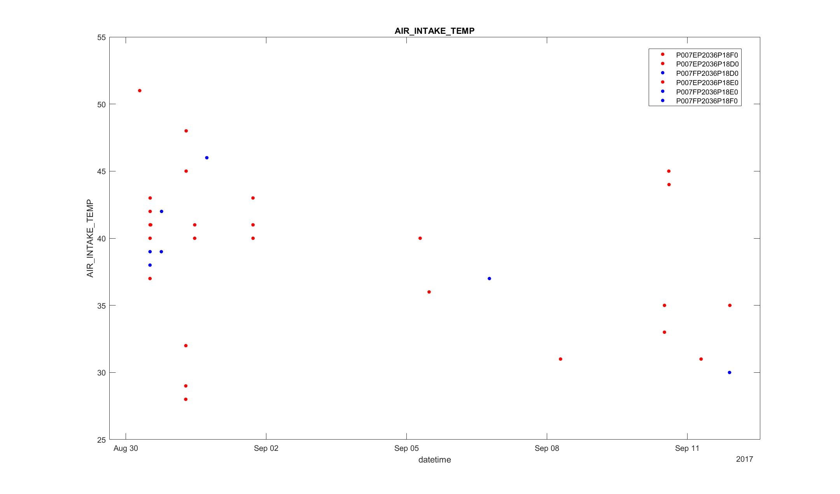
Intake temperatures are high for initial time stamps for P007E codes.

Slide 13
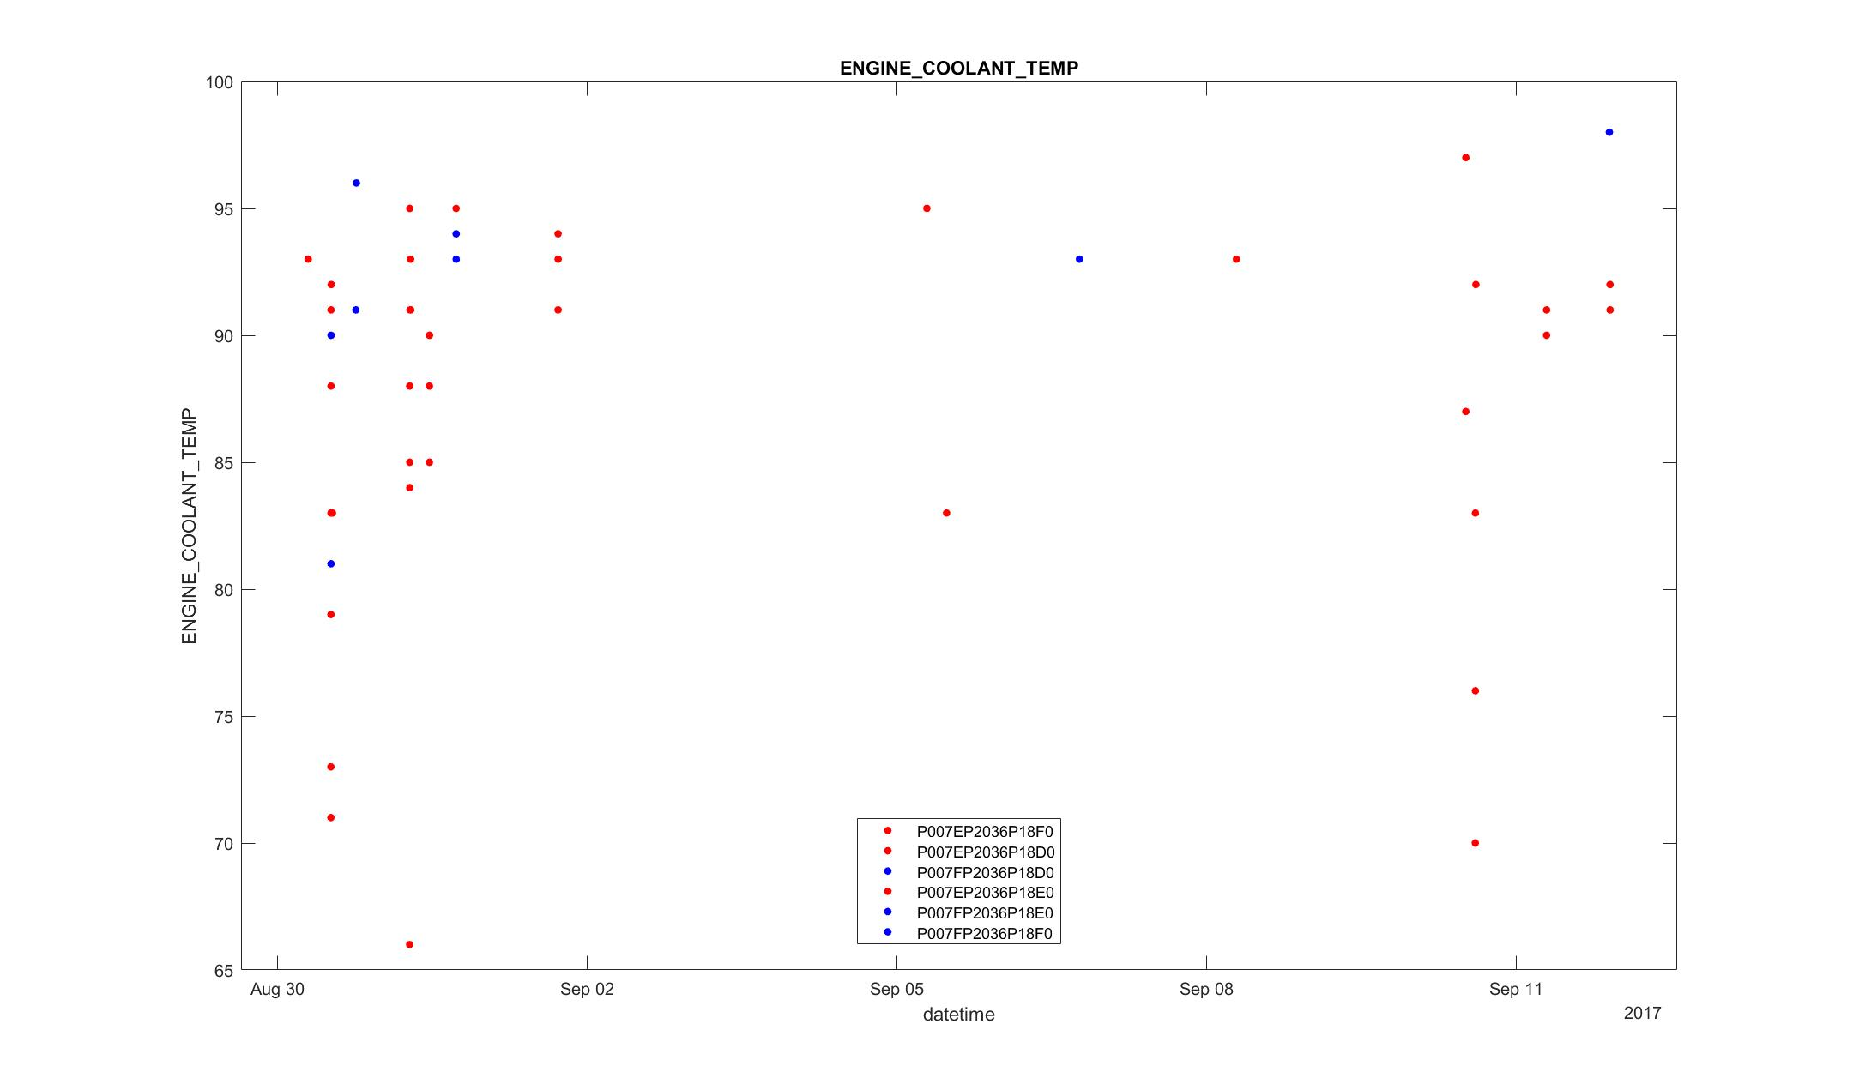
For P007F DTC code, coolant temperature is more as the engine heats up due to the failure of bank 2 and values for P007E varies widely with the timestamp.

Slide 14
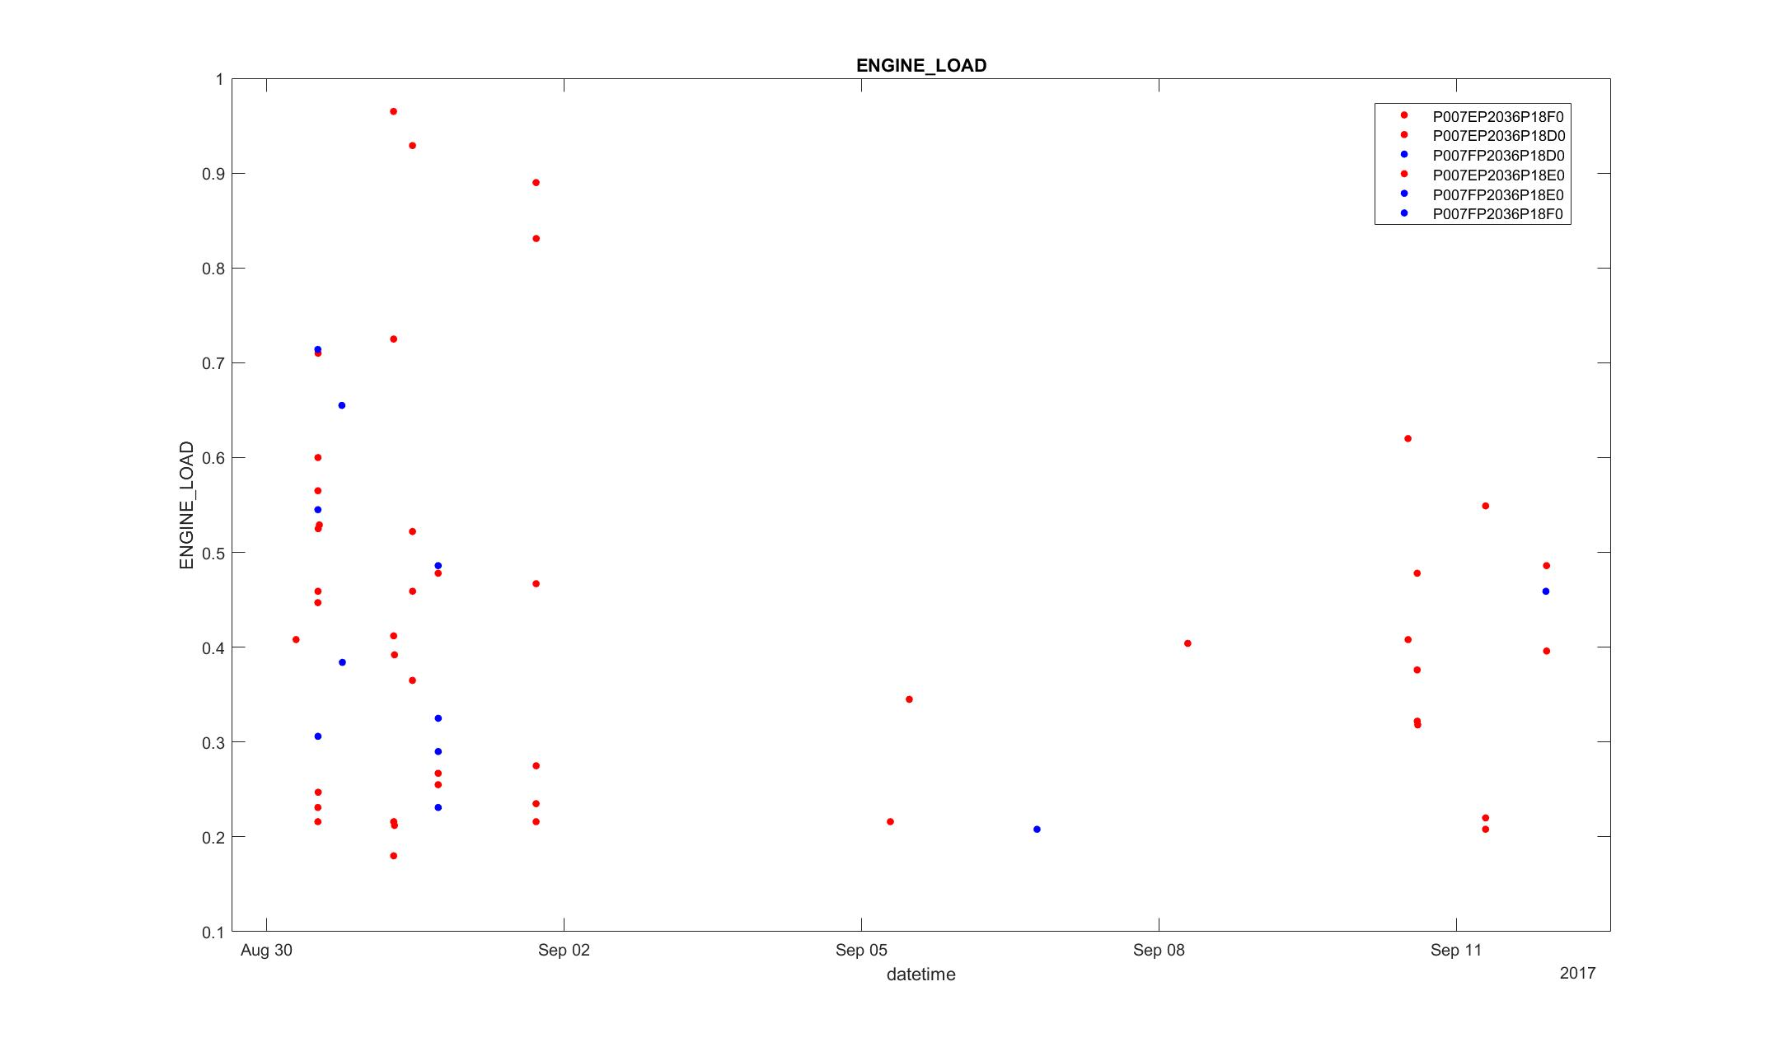
Engine Loads are especially high for P007E codes for initial timestamps.

Slide 15
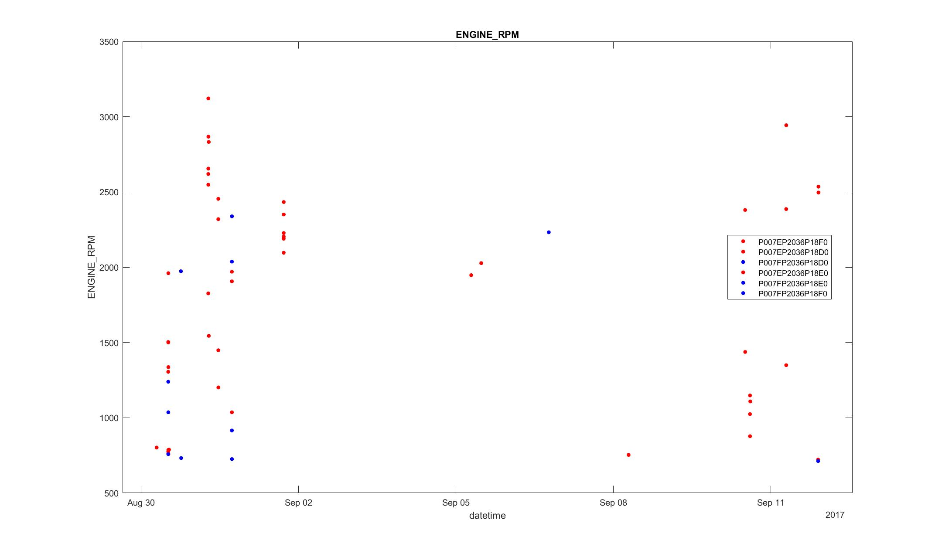

Slide 16
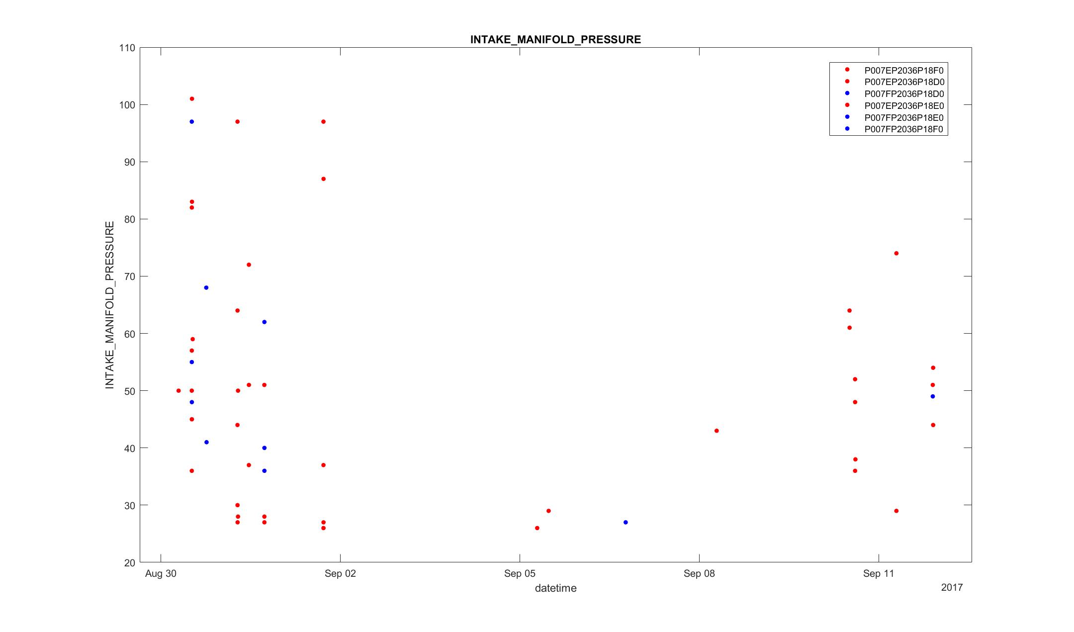
Air pressure is high for both the codes in initial timestamps

Slide 17
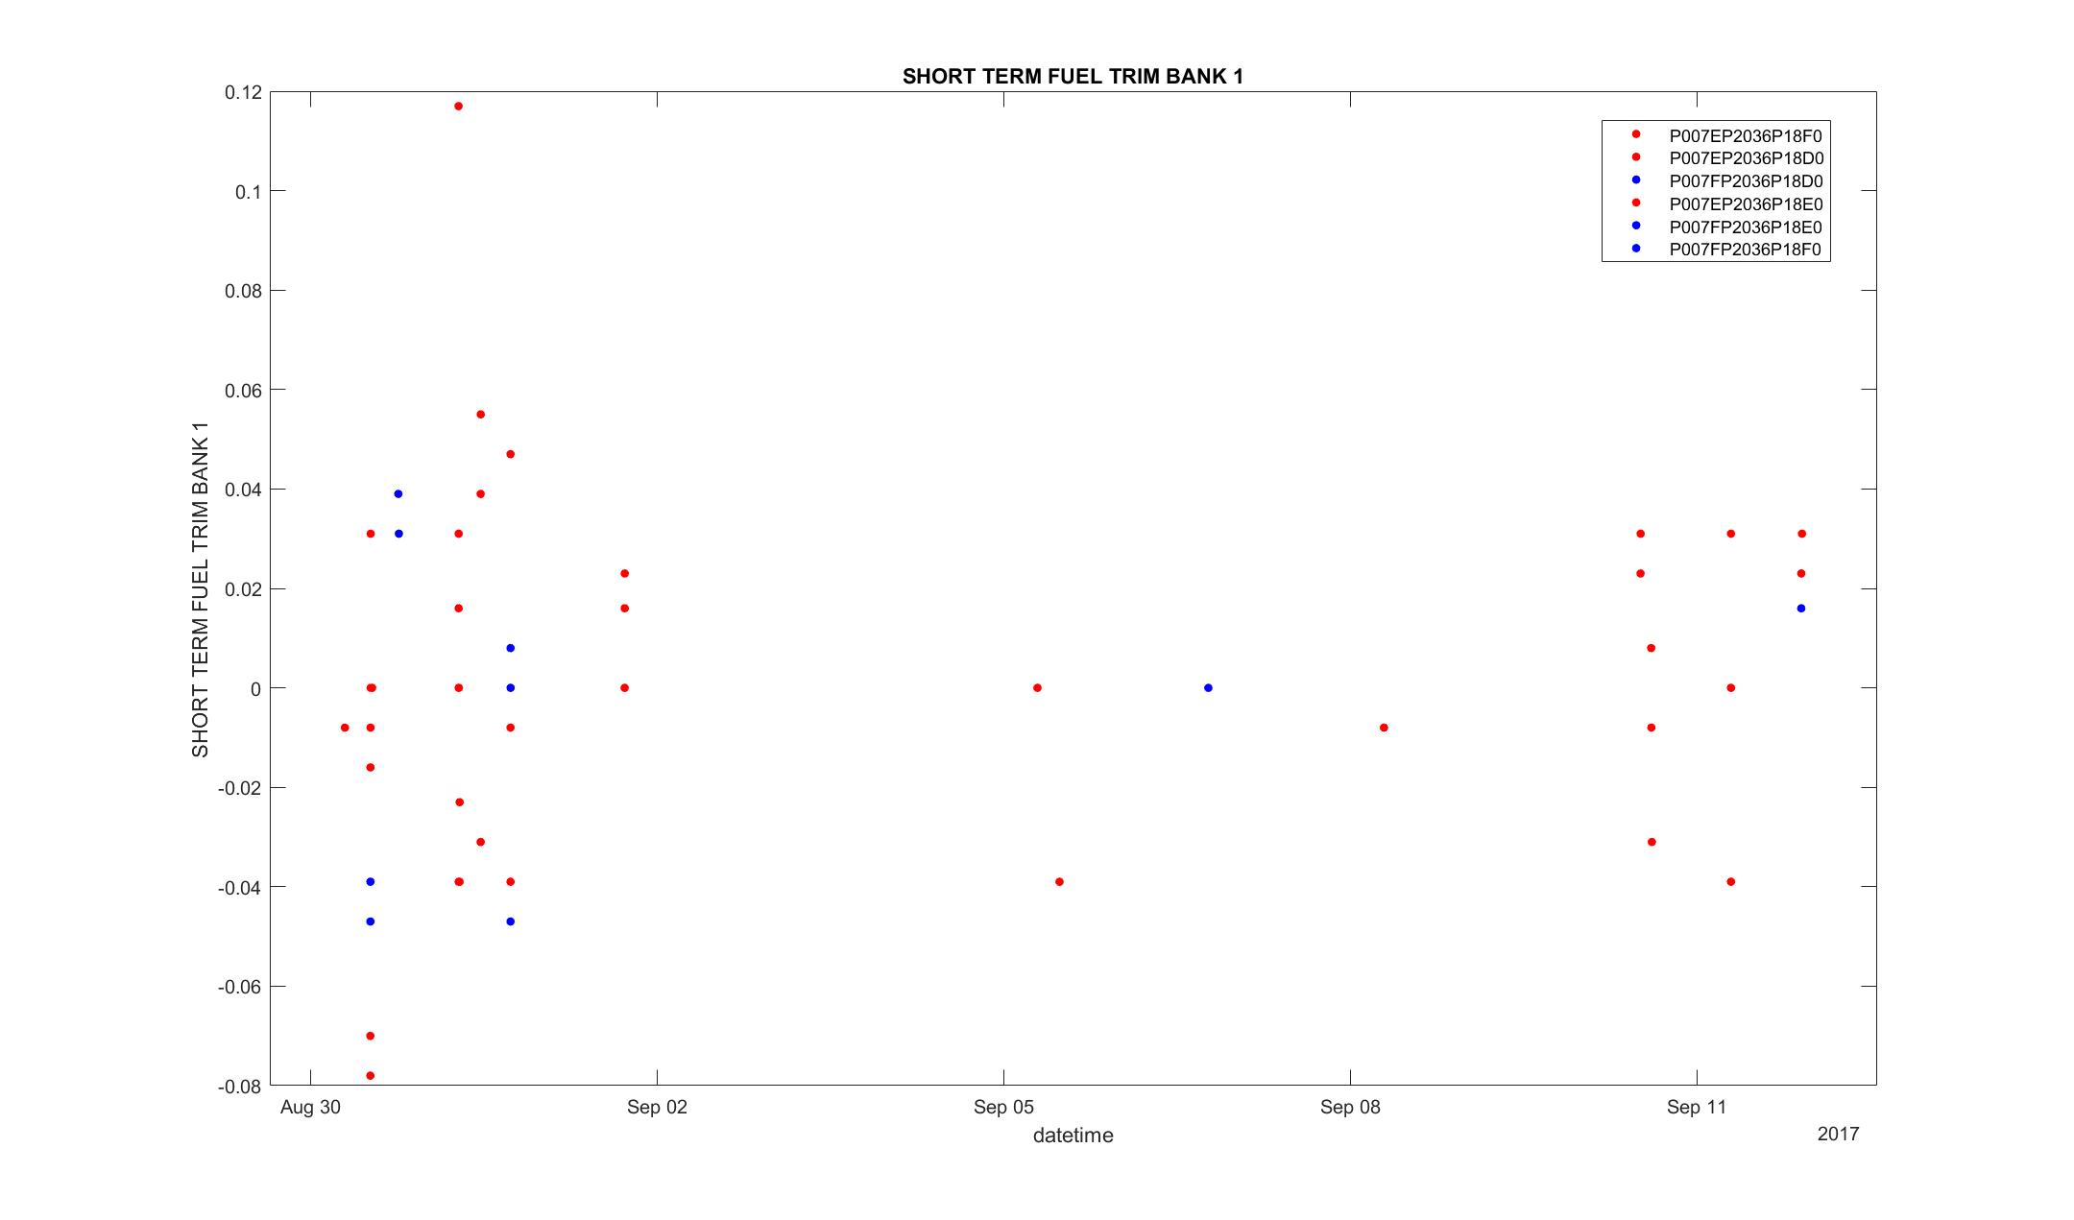
Fuel Trim values for bank1 are in ideal operating ranges for both the codes.

Slide 18
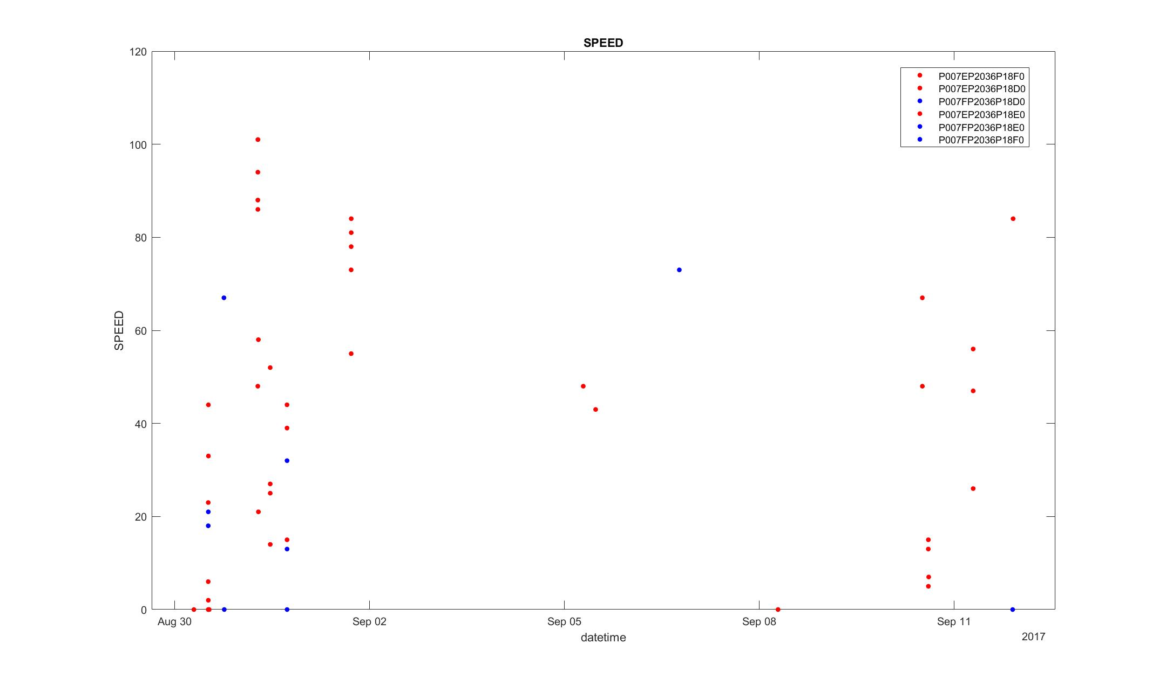

Slide 19
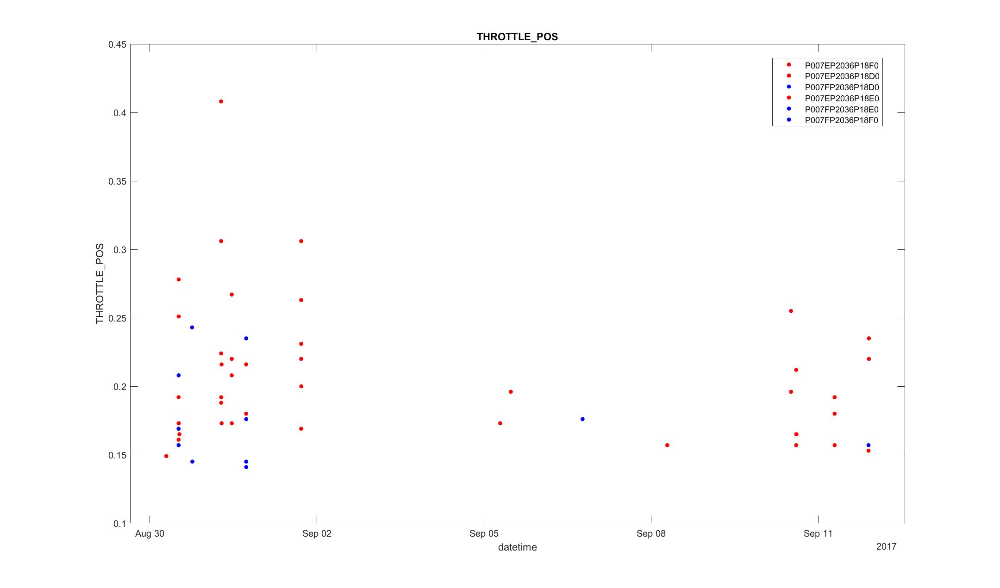

Slide 20
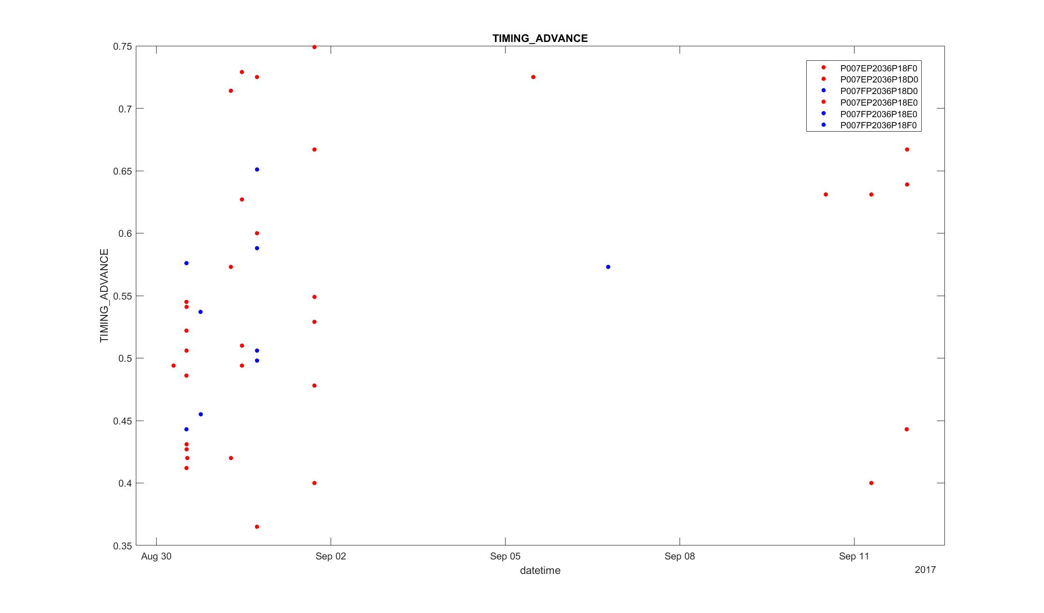
Timing advances varies widely, especially are higher for P007E codes compared to P007F codes.

Slide 21
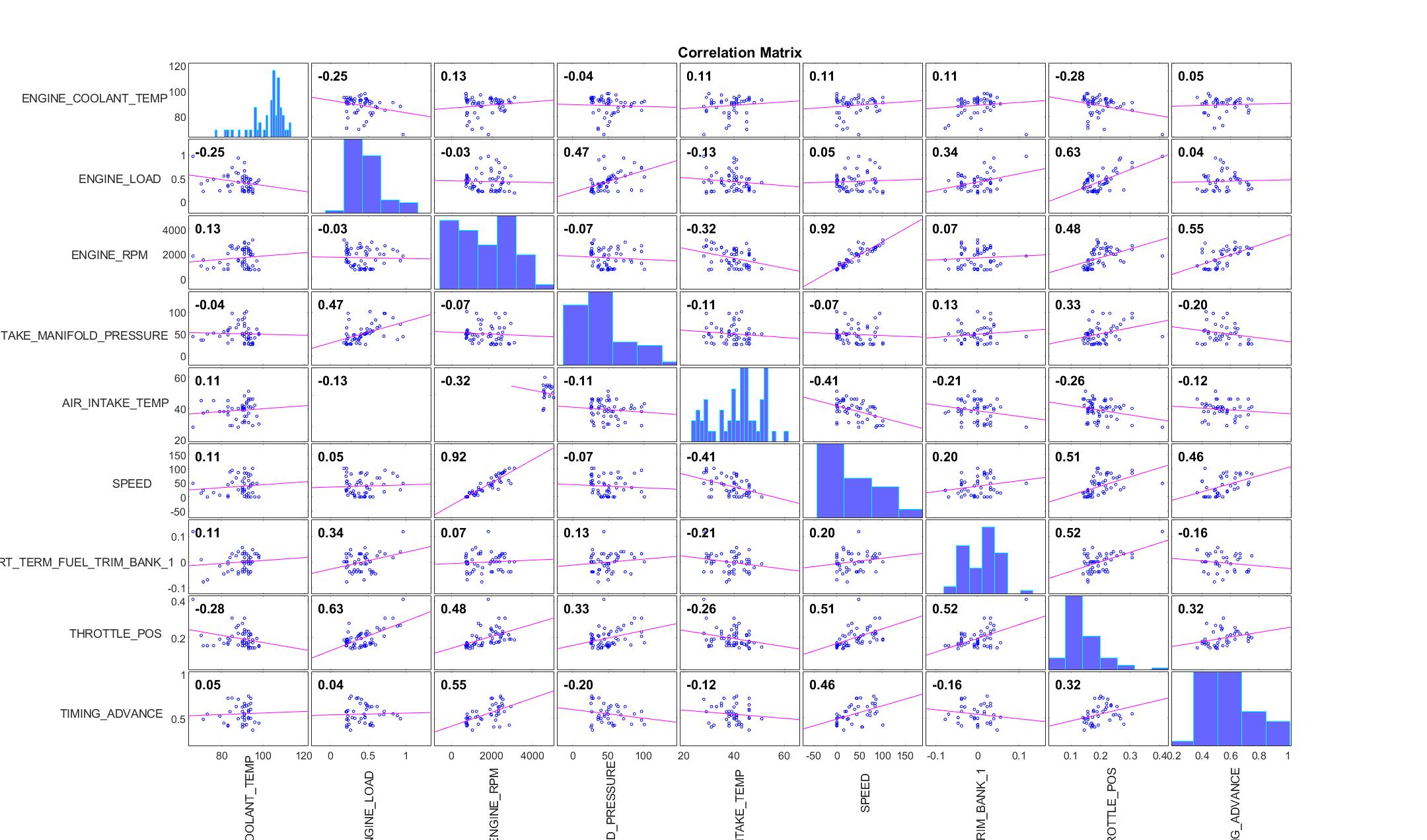

Slide 22
Insights
There are no sensor data’s for Short Term and Long Term Fuel Trim values for bank 2 , it implies that there is a problem with bank 2 of the engine while codes P007E & P007F are set.
There are sensor data’s for short term fuel trim values for bank 1, implies that bank 1 is able to get both fuel and air and also implies that our ECU is working.
From the correlation graph, the co-relations between Air Intake temperatures & Coolant Temperature, short term fuel trim bank1 & engine load are varying theoretically, implies bank 1 is working fine.
Normally the charge air cooler temperature sensor values are compared with Intake Air Temperature Sensor values to improve the efficiency of the engine. But, as there are no sensor data’s for MAF(Mass Air Flow) sensor, BAP( Barometric Air Pressure) sensor and Ambient Temperature Sensor(ATC) , implies that there would be disturbances in the charge air cooler (as there are no ATC and MAF values) and air flow into the banks.
On the whole, we could say that there are disturbances in the air flow temperatures (both input and exhaust) in bank 2 of the engine which led to set the codes P007F and P2036. There are also disturbances in the charge air cooler temperature sensors which led to set the code P007E.

Slide 23
Questions?

